Slide 1

Stream Processing
Zewail City of Science and Technology
Communications and Information Engineering (CIE) Program
Big Data Analytics (CIE 427) - Fall 2020
Original by: Muhammad Hamdy AlAref

Slide 2
Mini-Batches: Spark Streaming

Slide 3
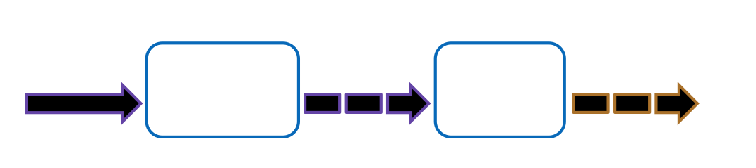
Overview
Spark Streaming is a Spark extension that receives live input data streams and divides the data into batches, called discretized stream or DStream, which can then be processed by the Spark engine.

Slide 4
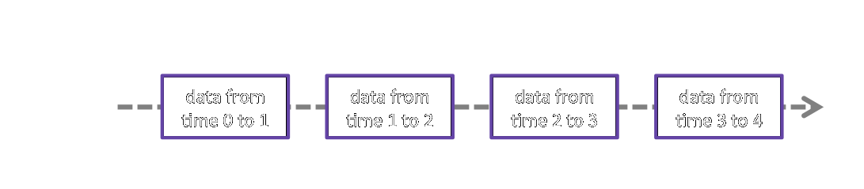
DStreams
A DStream is just as a sequence of RDDs.
DStreams can can be created from data sources, called input DStreams, or from applying transformations on other DStreams.

Slide 5
Input DStreams
Input DStreams are created from data sources and they serve as the starting point of the application.
Sources can be,
Basic sources directly available in the API.
Examples: file systems, and socket connections.
Advanced sources available through extra utility classes.
Examples: Kafka, Flume, Kinesis, etc.
Custom sources user-defined sources by implementing the Receiver interface in Scala and Java (not available in Python).

Slide 6
DStreams Transformations
DStreams expose most of the common RDD operations, e.g., map, flatMap, filter, reduce, etc., as DStream transformations that, when applied to a DStream, results in a new DStream by applying the operation to each of the underlying RDDs.
Additionally, an RDD-to-RDD transform function is exposed to apply any of the non-exposed RDD operations.

Slide 7
DStreams Stateful Transformations
A particularly interesting DStream transformation is updateStateByKey which enables defining and updating a long-running state over all the RDDs in the DStream!
A state can be of any data type and it gets updated with new values in each batch.
For example, in a streaming variant of the word count example, the state can be defined as the count of each word so far, and it gets updated by each new batch by adding the number of occurrences of each word in the batch to its long-running count.

Slide 8
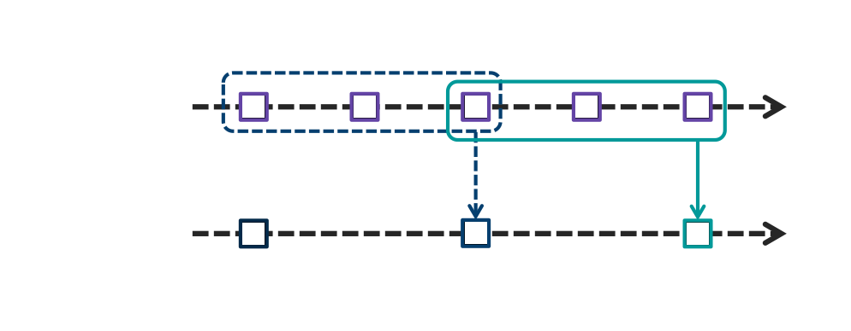
DStreams Windowed Transformations
Another interesting type of DStream transformations are windowed transformations which enables processing on multiple RDDs within a window.
A window is defined by two parameters; its length & sliding interval.

Slide 9
DStreams Output Operations
DStreams flow usually ends with some sort of output operation!
Built-in output operations include printing to the terminal and saving to files.
A generic output operation, foreachRDD, is also exposed to enable more flexibility and customizations, e.g., pushing the output to another system.

Slide 10
DStreams Checkpointing
Since streaming applications are expected to operate 24/7, DStreams support the notion of checkpointing. That is, they can periodically store information to a fault-tolerant storage system such that they can recover from failures.
There are two types of checkpointing,
Metadata checkpointing Saving of the information defining the streaming computation. This is used to recover from failure of the node running the driver of the streaming application.
Data checkpointing Saving of the generated RDDs to reliable storage. This is necessary in some stateful transformations that combine data across multiple batches.

Slide 11
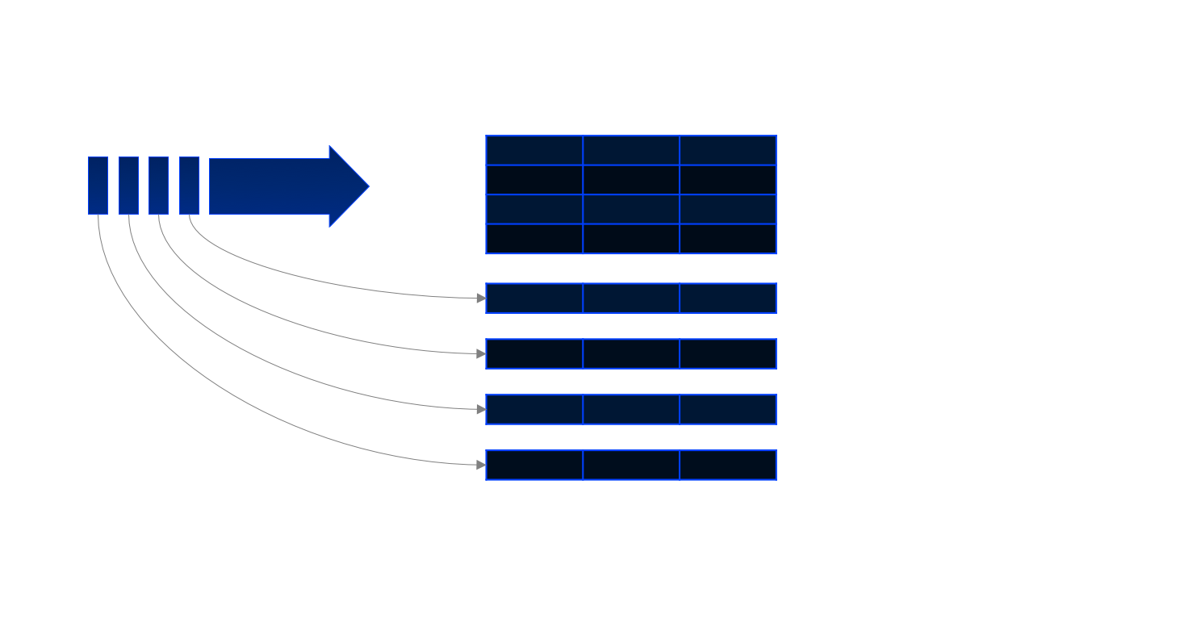
Alternative API: Structured Streaming (SQL)

Slide 12
Word Count Demo

Slide 13
Kappa Architecture: Storm

Slide 14
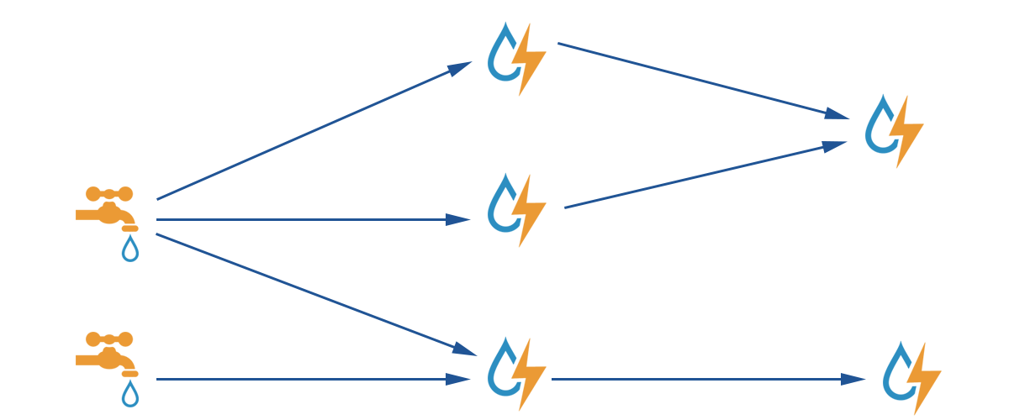
Overview
Processes data “in motion” by defining topologies of sources (spouts) and transformations (bolts).

Slide 15
Spouts and Bolts
Spouts emit streams. A spout is defined by implementing a method that emits the next tuple NOT the stream as a whole!
Bolts consume any number of streams, processes it and may or may not emit a new stream. A bolt is defined by implementing a method that processes one tuple NOT the stream as a whole!

Slide 16
Topologies
Topologies define spouts and bolts and their connectivity.
A spout or a bolt can have any number of tasks; that is, number of instances concurrently processing tuples.
A bolt subscribes to one or more streams with a grouping.
A grouping specifies how tuples are distributed among a bolt’s tasks.

Slide 17
Unified APIs

Slide 18
Flink
More expressive semantics for streaming.
Batches can simply be considered bounded streams.
Mature enough Java and Scala APIs.
Python API in development.

Slide 19
Beam
Collaboration between Apache, data artisans and Google.
Very similar API to Flink.
Java, Python and Go APIs.
Programs can be directly or on top of Flink, Spark, Apex, Dataflow and others with little to no modification!

Slide 20
Requirement: Twitter Trends
Given Twitter feed at a socket, use Spark Streaming to count the used hashtags every time interval, e.g., 30 seconds.
That is, specify a mini-patches interval and apply some hashtags counting transformations to each mini-patch!

Slide 21
Acknowledgement
A lot of the material introduced in Spark Streaming were adapted from the official Apache Spark documentation.
A lot of the material introduced in Storm were adapted from the official Apache Storm documentation.

Slide 22
Thank you!

